Slide 1
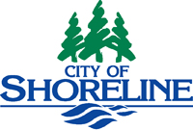
Southeast Neighborhoods Subarea Plan Implementation
October 21, 2010
Planning Commission Study Session

Slide 2
Background- Subarea Plan Adoption
Council voted unanimously to adopt the Southeast Neighborhoods Subarea Plan on May 24, 2010
Subarea Plan contained Comprehensive Plan Map and Policy Recommendations
Implementation options were an agenda item at the July 1st Planning Commission meeting, and the August 2nd joint Commission/Council meeting
Community meeting was held on September 21st to discuss implementation options with residents of subarea

Slide 3
Comprehensive Plan *Adopted by City Council in May 2010

Slide 4
Implementation Options Presented Previously
Implement vision for subarea using:
1) Only existing zoning categories
2) Existing as well as new zoning categories, such as
R-36 and/or a Mixed Use Zone geared towards residential neighborhood commercial districts
3) The above, in conjunction with Planned Areas in one or more locations
Staff recommendation utilizes combination of these options

Slide 5
Staff Recommendation
Existing zoning is retained for the bulk of the properties within the subarea
One new zoning category is proposed- A less intense version of the Mixed Use Zone for parcels adjacent to 15th Ave.
Not recommended: Creation of a new R-36 residential zoning district
One Planned Area is proposed, in the SE corner between Bothell Way and 145th Ave.

Slide 6
Staff Recommendation

Slide 7
Proposed Zoning Changes

Slide 8
Issues Raised in Comment Letters
Traffic- Perception that existing safety issues preclude additional development
Hydrology- Perception that groundwater table is high, which should preclude additional development
Crime and inter-jurisdictional coordination- Suggestion for lighting and communications planning
Transition Zoning- Requests to align the map more closely with Policy Recommendations to step-down zoning
Transit-Oriented Development- Suggestion to incorporate TOD into Planned Area for SE corner

Slide 9
Neighborhood Traffic Action Plan

Slide 10
Transition Zoning

Slide 11
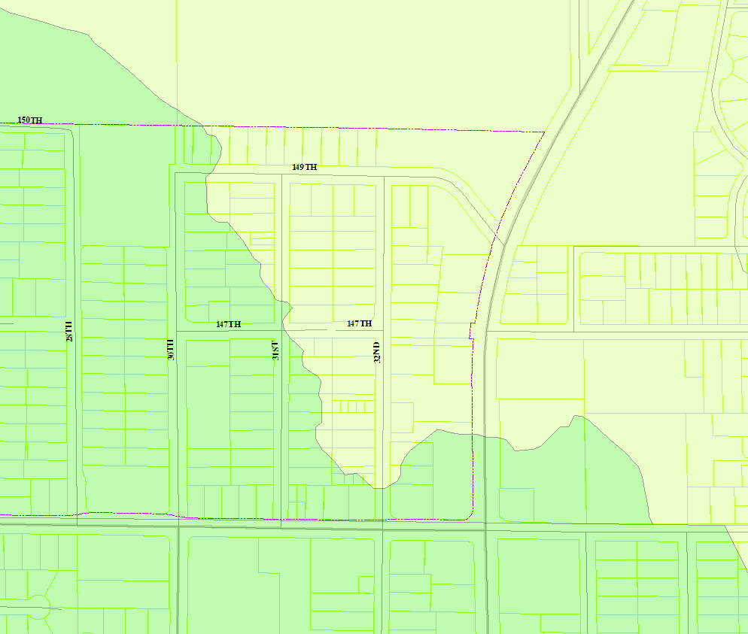
Drainage Basins Thornton Creek- Hamlin Creek West Lake Washington
Notes:
Both basins are essentially fully built out. Meaning that the maximum allowed amount impervious surfaces already exists. Max allowed impervious surface is based on land use.

Slide 12
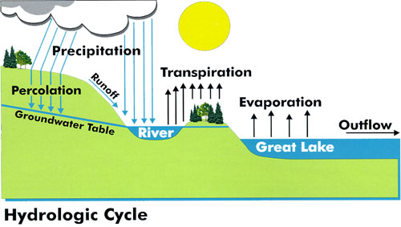
Hydrology
Notes:
Forested conditions – Natural hydrology
Developed conditions Increase surface water runoff.

Slide 13
Forest <1% runoff Post Development 20-30% runoff
Notes:
Previous to the early 1990”s no consideration for surface water. Current condition in the Hamlin Creek Subbasin and the West Lake Washington Basin is uncontrolled surface water runoff, except for newer developments.

Slide 14
Surface Drainage Patterns
Notes:
Drainage separated by basins. Rough estimate based on topography and what is known.

Slide 15
Standards
NPDES Phase II Permit
Department of Ecology
SMC 13.10
Notes:
NPDES Phase II, issued by DOE to City. Sets surface water requirements the City must meet.
DOE Surface Water Design Manual for Western Washington
Experts from DOE, King County, Puget sound Water quality Team, fish and wildlife, Utility companies, Cities, counties, watershed groups
SMC 13.10 spells out the requirements applicable to development

Slide 16
Development
Low Impact Development
Manage surface water onsite
Minimum Surface Water Impacts
Limit surface water release
Adequate Infrastructure
Notes:
Any development that can not mitigate impacts must adjust proposal until it meets the specific onsite and offsite conditions. SMC 13.10 requires Low impact development.
For projects triggering flow control, any water that is not managed onsite must be held onsite and released at a metered rate. (detention)
5,000 SF NEW Impervious Surface = Flow Control
Adequate infrastructure is listed here because this may be a problem in this area. Depend on how much low impact development onsite and also what sort of frontage improvements will be installed.

Slide 17
Questions???
Miranda Redinger
Project Manager, Associate Planner
mredinger@shorelinewa.gov
206-801-2513
Steve Cohn
Project Manager, Senior Planner
scohn@shorelinewa.gov
206-801-2511
Jill Mosqueda, P.E.
Development Review Engineer
jmosqueda@shorelinewa.gov
206-801-2528
Project web page
http://shorelinewa.gov/index.aspx?page=178

Slide 18
CAC Recommendation

Slide 19
Minority Report Recommendation

Slide 20
Comprehensive Plan Policy LU11:
The Medium Density Residential land use designation is intended for areas currently developed with medium density residential dwelling uses; and to areas where single family detached dwelling units might be redeveloped at slightly higher densities; and to areas currently zoned for medium density residential. Single family dwelling units, duplexes, triplexes, zero lot line houses, townhouses and cottage housing will be permitted. Apartments will be allowed under certain conditions.
The permitted base density for this designation may not exceed 12 dwelling units per acre unless a neighborhood plan, subarea plan or special district overlay plan/zone has been approved…

